Slide 1
Base Erosion and Profit Shifting (BEPS),
Tax Avoidance and Black Money
Porus Kaka
Senior Advocate and President, International Fiscal Association
January 16, 2016

Slide 2

International tax law is a key pillar in supporting growth of the global economy

Slide 3
Base Erosion and Profit Shifting (BEPS)
OECD initiative, approved by the G20
Designs adopted by corporations to avoid taxation
Exploits loopholes in tax laws and legal regulations
Involves profit ‘disappearing’ or, shifting of gains to tax heavens
Practice of BEPS is not illegal

Slide 4

Background
July 2012
Media coverage: ALP is broken
June: OECD CFA decision to diagnose BEPS
June: G20 leaders in Los Cabos
“We reiterate the need to prevent BEPS and we will follow with attention the on-going work of the OECD in this area”

Slide 5
Background
November 2012
G20 Finance Ministers 4-5 November
“We also welcome the work that the OECD is undertaking into the problem of base erosion and profit shifting and look forward to a report about progress of the work at our next meeting.”
12-13 November: Hearing Public Accounts Committee UK
12- 14 November: Public Consultation on the Revised Intangibles Draft
“OECD’s intangibles draft : WP6 delegates are uniformly of the view that legal ownership and bearing of costs related to intangibles development, taken separately or together, does not entitle an entity to retain the intangible related returns without more.”

Slide 6
What is BEPS?
Core work of the OECD is to remove barriers to cross-border trade and investment through designing international standards to eliminate double taxation
Many rules work well but some may have also resulted in double non-taxation
Governments need resources and to ensure the fairness of the tax system
Prevention of double taxation important but recognition that the issue of double non-taxation due to base erosion and profit shifting
Number of structures take advantage of asymmetries in domestic and international tax rules
Artificial separation of allocation of taxable profits from the jurisdiction where these profits arise/the place of economic activity

Slide 7

Countries involved
Fully endorsed by the G20 and is supported by the governments and tax authorities of some big economies
For the first time ever in tax matters, non-OECD/G20 countries are involved on an equal footing
More than 60 countries as signatory, including China, India, Switzerland

Slide 8

Key pressure points on Governments
9th report of the UK’s Public Accounts Committee based on the minimal taxes paid in UK despite generating revenue to the tune of US$ 18billion
No Corporation Tax paid by major MNC in UK between 2009 & 2012 despite having sales figure of £400million in UK. It has reportedly paid / will pay £10million in 2014
US companies have more than $1.5trillion sitting offshore allegedly to avoid taxes in US
As per US Senate investigation reported
by various media, leading Computer
manufacturer, has paid only 2 per cent
tax on income of $74 billion over the
past three years, though legally

Slide 9

The OECD Report: Overview
How Big a problem is BEPS?
An Overview of the Available Data
  In 2010, Barbados, Bermuda & the British Virgin Islands (BVI) received more FDI (combined 5.11% of global FDI’s) than Germany (4.77%) or Japan (3.76%). They also made more investments (combined 4.54%) into the world than Germany at 4.28%.
  In 2010, the BVI was the second largest investor into China (14%) after Hong Kong (45%) and before US (4%)
  Mauritius is the top investor country
  into India (24%)
  Cyprus (28%), the BVI (12%), Bermuda (7%) and the Bahamas (6%) are among the top five investors into Russia

Slide 10
Action Plan 1 to 15 (1/3)
Addressing the Tax Challenges of the Digital Economy (Action 1)
Neutralizing the Effects of Hybrid Mismatch Arrangements (Action 2)
Designing Effective Controlled Foreign Company Rules (Action 3)
Limited Base Erosion Involving Interest Deductions and Other Financial Payments (Action 4)

Slide 11
Action Plan 1 to 15 (2/3)
Countering Harmful Tax Practices More Effectively, Taking into Account Transparency and Substance (Action 5)
Preventing the Granting of Treaty Benefits in Inappropriate Circumstance (Action 6)
Preventing the Artificial Avoidance of Permanent Establishment Status (Action 7)
Aligning Transfer Pricing Outcomes with Value Creation,(Action 8-10)

Slide 12
Action Plan 1 to 15 (3/3)
Measuring and Monitoring BEPS (Action 11)
Mandatory Disclosure Rules (Action 12)
Transfer Pricing Documentation and Country by Country Reporting (Action 13)
Making Dispute Resolution Mechanisms More Effective (Action 14)
Developing a Multilateral Instrument to Modify Bilateral Tax Treaties (Action 15)

Slide 13
Main aspect of BEPS effecting India
Measure to deal with treaty shopping
Other forms of treaty abuse
Transfer pricing rules in the area of intangible & country by country reporting
Improved transparency and documentation on transfer pricing by tax authorities
Digital Economy
Intangibles

Slide 14
Exchange of information
To disclose or not to disclose swiss bank A/c
    Ram Jethmalani vs. Union of India 339 ITR
    107(SC)
    Press release dated 18/10/2014
Not prohibited the government from entering into treaty on commitment to maintain the confidentiality of information received
    Prevention under ‘rights to privacy’
    If disclosure made in public court proceedings, India would default & not receive new information

Slide 15
BEPS – Rules
France / Germany
Raoul Weil – Swiss Banker arrested in Italy for crime in US and then extradited
US fought Swiss Bank to closure oldest Swiss Bank Weghelin had to close down

Slide 16
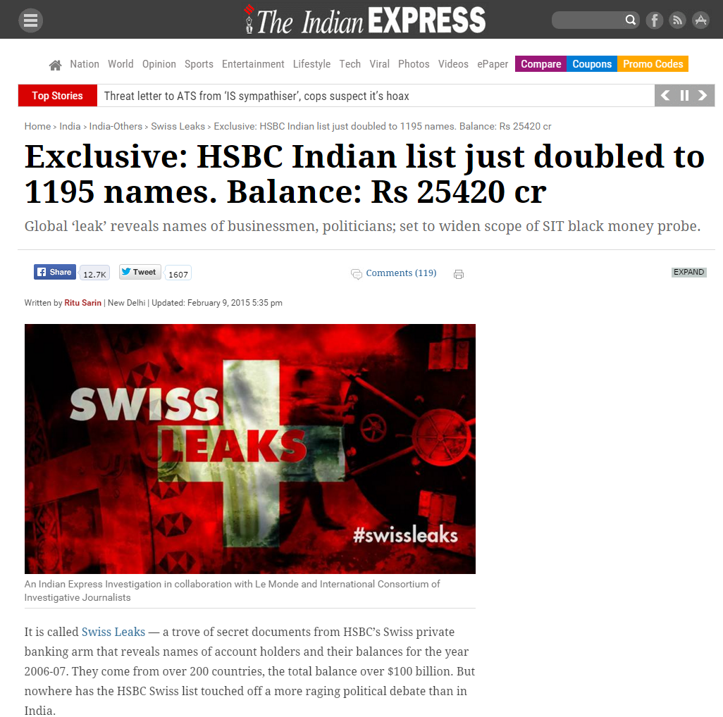
Exclusive: HSBC Indian list just doubled to 1195 names. Balance: Rs 25420 cr*

Slide 17
Action 1 deals with broader direct and indirect tax challenge raised by the digital economy and evaluates options to address these challenges
Action 2 consists of two parts with detailed recommendations to address hybrid mismatch arrangements and reflects the consensus achieved on these issues
Action 3 provides recommendations for what it describes as the “building blocks” of CFC rules
The final report on Article 5 covers two main areas: (i) the definition of a “substantial activity” criterion to be applied when determining whether tax regimes are harmful and (ii) improving transparency.

Slide 18
Action 6, contains model tax treaty provisions and related changes to the model commentary to address the inappropriate granting of treaty benefits and other potential treaty abuse scenarios
Final Report is organized in 3 sections
  Section A includes anti-abuse provisions that provide safeguards against the abuse of treaty provisions
  Section B to clarify that the intention is to eliminate double taxation without creating opportunities for non-taxation or reduced taxation through tax evasion and avoidance, including through treaty shopping arrangements
  Section C identifies tax policy considerations relevant to the decision to enter into a tax treaty with another country

Slide 19
Action 7 Report or Final Report), proposes changes to the permanent establishment (PE) definition in Article 5 of the OECD Model Tax Convention (the OECD Model) to prevent the use of certain arrangements that are considered to enable a foreign enterprise to operate in another country without creating a PE

Slide 20
Action 8 to 10 provide guidance on strengthening and clarifying the arms length principles
Action 11 improving the availability and analysis of data on BEPS and to develop measures of the scale and effects of BEPS behaviours, and to monitor the impact of measures taken under the action plan to address BEPS

Slide 21
  Action 12 deals with mandatory disclosure regimes can provide tax authorities with this information and such regimes have a number of advantages over other forms of disclosure initiatives
  Action 13 provide tax administrations with the information necessary to conduct an informed transfer pricing risk assessment

Slide 22
Action 14 report presents a commitment by countries to implement a so called “minimum Standard on dispute resolution according to the OECD
Action 15, provides an overview of the current status of the multilateral instrument, which aims to swiftly and consistently implement the tax treaty-based measures developed during the course of the BEPS project

Slide 23
Action Plan 11 Objectives
Improving the availability and analysis of data on BEPS
To develop measures of the scale and effects of BEPS behaviours, and to monitor the impact of measures taken under the Action plan to address BEPS
Outcome based techniques which look at measures of the allocation of income across jurisdictions relative to measures of value creating activities
Outcome based techniques, which identify the types of data that taxpayers should provide to tax administration

Slide 24

Establish methodologies to collect and analyse data on BEPS and the actions to address it (Action 11)
Produce an overview of several different economic analyses of BEPS using different data and methodologies that will give a potential range of the scale and economic impacts
Ensure that tools are available to monitor and evaluate the effectiveness and economic impact of the actions taken to address BEPS on an ongoing basis
Identifying and assessing a range of
existing data sources
Improving the availability and
analysis of data
Identify the type of data that taxpayers
should provide to tax administrators

Slide 25
What was given?

Slide 26
Require taxpayers to disclose their aggressive tax planning arrangements (Action 12)
Mandatory disclosure regimes can provide tax authorities with this information and such regimes have a number of advantages over other forms of disclosure initiatives
Objective – capture international tax scheme
Provides an overview of mandatory
disclosure regime
Set out recommendations for a model design
Note Caveat

Slide 27
Existing Mandatory disclosure regimes do share key design principles
Mandatory disclosure rules should be clear and easy to understand
Mandatory disclosure rules should balance additional compliance costs to taxpayers with the benefits obtained by the tax administration.
Mandatory disclosure rules should be effective in achieving the intended policy objectives and accurately identify relevant scheme
Information collected under mandatory disclosure should be used effectively

Slide 28
3 key Outputs
Recommendations for the modular design of mandatory disclosure rules to provide flexibility for country specific needs
1
A focus on international tax scheme and consideration of a wide definition of tax benefit to capture relevant transaction
2
Designing and putting in place enhanced models of information sharing for international tax scheme
3
May 2015 draft addresses first two outputs

Slide 29
Main objective of Mandatory disclosure rules
Obtaining early information about tax avoidance schemes
Identifying schemes, and
the users and promoters
of scheme
Acting as a deterrent
to reduce the promotion
and use of avoidance schemes

Slide 30
Re-examine transfer pricing documentation (Action 13)

Slide 31
Objectives of transfer pricing documentation requirements
Provide tax administrations with the information necessary to conduct an informed transfer pricing risk assessment
Taxpayers gives appropriate consideration to transfer pricing
Appropriately thorough audit of the transfer pricing
Purpose is for Tax administrations to access information for conduct of risk assessment

Slide 32
Final 3 tier approach to transfer pricing documentation
1
Master file containing standardized information relevant for all MNE group member
2
A local file referring specifically to material transaction of the local taxpayer
3
A country by country report containing certain information relating to the global allocations

Slide 33
Final model template key contents (1/3)
A model Template for the country by country reporting
Table 1. Overview of allocation of Income, taxes and business activities by tax jurisdiction
Name of the MNE Group : Fiscal Year Concerned:
Tax Jurisdiction | Revenues |  |  | Profit (loss) Before Income Tax | Income Tax paid (on cash basis) | Income Tax Accrued– Current year | Stated Capital | Accu-mulated Earning | Numbers of Employees | Tangible Assets other than cash and cash Equivalents
 | Un-related Party | Related Party | Total

Slide 34
Final model template key contents (2/3)
Table 2: List of all the constituent entities of the MNE group included in each aggregation per tax jurisdiction
Name of the MNE Group : Fiscal Year Concerned:
Tax Juris-diction | Constituent entities resident in the Tax Jurisdiction | Tax Jurisdiction of organisation or incorporation if different from Tax Jurisdiction of Residence | Main business activity(ies)
 |  |  | Research and development | Holding or managing intellectual property | Purchasing or procurement | Manufacturing or production | Sales, marketing or distribution | Administrative, management support services | Provision of services to unrelated parties | Internal group finance | Regulated financial services | Insurance | Holding shares of other equity instruments | Dormant | Other*
 | 1.
 | 2.
 | 3.
 | 1.
 | 2.
 | 3.
* Please specify the nature of the activity of the constituent entity in the “additional information” section

Slide 35
Final model template key contents (3/3)
Table 3 Additional Information
Name of the MNE Group: Fiscal Year Concerned:
Please include any further brief information or explanation you consider necessary or that would facilitate the understanding of compulsory information provided in country by country report

Slide 36
Application of BEPS by Indian Court
Additional Director of Income-tax, (International Taxation), Dehradun v. Baker Hughes Singapore Pte Ltd 57 taxmann.com 191 (Del)(ITAT)
“As for the BEPS considerations, base erosion and profit shifting is a tax policy consideration which is relevant for the process of law making, but it cannot have a role in the judicial decision making process because judicial process will infringe neutrality if it is to be swayed by such policy consideration”

Slide 37
Indian Judiciary’s Role in solving International Tax Disputes
Maximum International tax judgments from India, more than all countries put together
Onerous responsibility on judiciary
True for both domestic and international disputes
Madras Bar Association vs. Union of India [368 ITR 42 (SC)]

Slide 38
International Association of Tax Judges (IATJ)
A forum for judges to share information, knowledge and an exchange of their views
Held five general Assemblies till date
Sixth Assembly in Lucerne, Switzerland, on September 4 and 5, 2015
For more information: http://www.iatj.net/

Slide 39
IFA
Largest non sectoral tax organization in the world
Established in 1938
Signature annual congresses held across the world
– 2014 Mumbai

